Slide 1
Library Level Patron Notifications
Yoel Kortick
Senior Librarian

Slide 2

  Introduction
  For example
  Configurations based on library - Borrowing Activity Letter
Agenda

Slide 3
Introduction

Slide 4
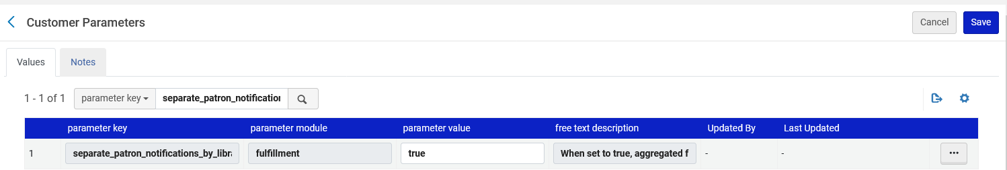
Introduction
Institutions can configure Alma so that patron notification letters that aggregate information from multiple libraries, such as Borrowing Activity Letter, Courtesy Letter, Ful Requests Report Letter, Ful Overdue And Lost Loan Notification Letter, etc. will be aggregated and sent per library.
This can be done by enabling the separate_patron_notifications_by_library customer parameter at 'Configuration > Fulfillment > General > Other Settings'
Currently we have set the parameter to "true"

Slide 5
Introduction
The resulting letters will be sent from the specific library, allowing Alma institution to configure library conditions in the letter XSL.
Notes:
When a notification is triggered - if divided by libraries, multiple notifications will be sent (e.g. when sending an activity report from the patron workbench - if the patron has loans or fines in more than one library, an activity report will be sent for each such library).
Fulfillment entities will be divided by owning library. If no owning library exists (e.g. for a fine or fee owned by the institution, or a request that may be served by multiple libraries) - a letter will be sent by the institution.
The owning organization unit for short loans' Courtesy Letter, sent for a single loan, will be the owning library - to align with the new behavior of the letter.
If an overdue and lost loan profile is configured to generate a notification fee, and several notifications are sent by this profile for different libraries - a fee will be charged for each notification.

Slide 6
For example

Slide 7
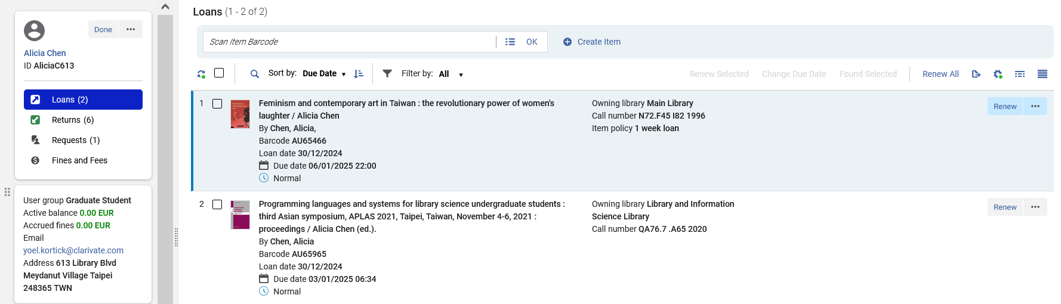
For example
Patron Alicia Chen has two items on loan: One in the "Main Library" and one in the "Library and Information Science Library"

Slide 8
For example
Parameter "separate_patron_notifications" is set to "true"

Slide 9
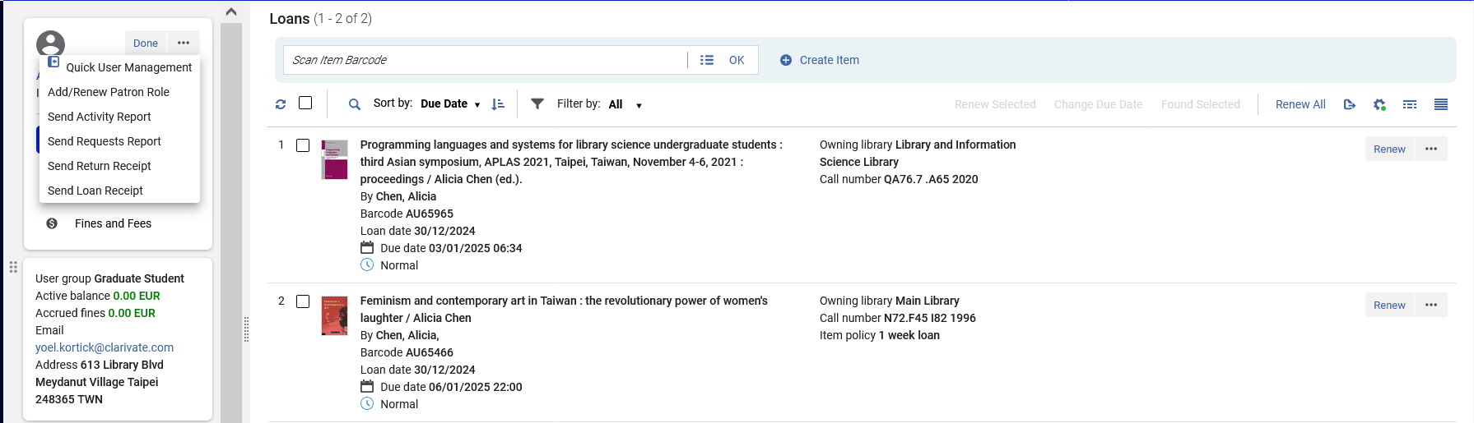
For example
The borrowing activity letter is sent

Slide 10
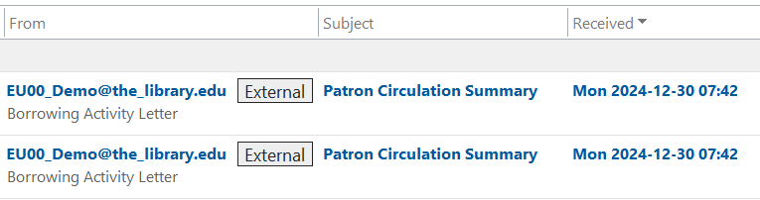
For example
Two separate mails are simultaneously sent

Slide 11
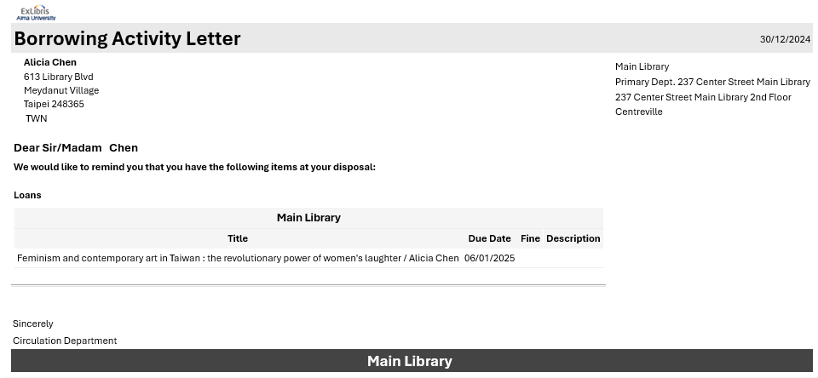
For example
One letter is sent for the "Main Library"

Slide 12
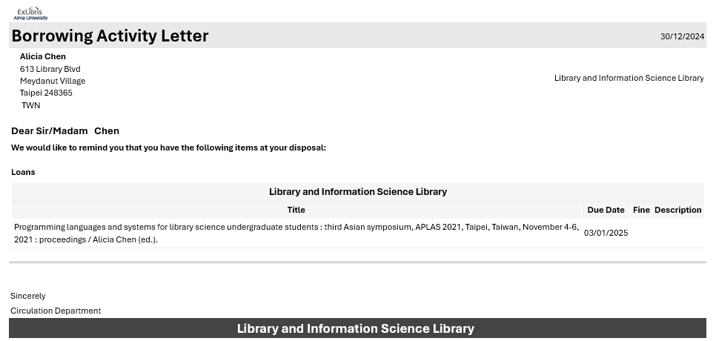
For example
One letter is sent for the "Library and Information Science Library"

Slide 13
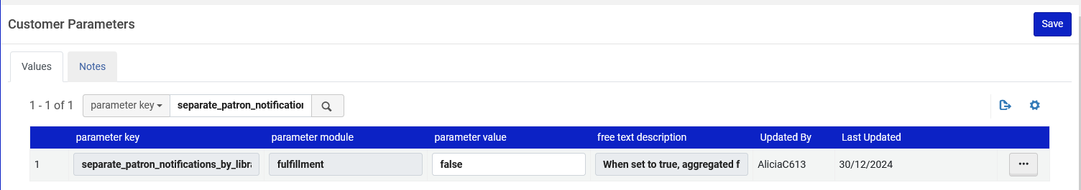
For example
However, if parameter "separate_patron_notifications" is set to "false"

Slide 14
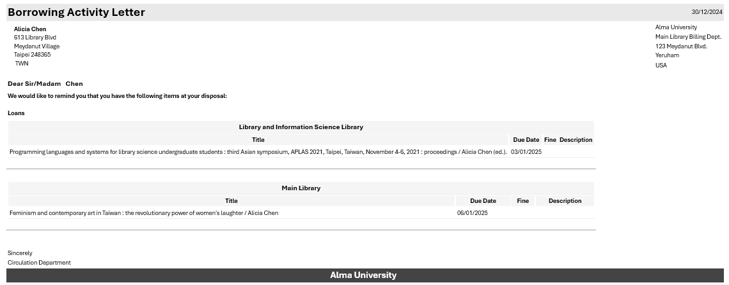
For example
Then one letter is sent with all items on loan in all libraries

Slide 15
For example
Again the parameter "separate_patron_notifications" is set to "true"

Slide 16
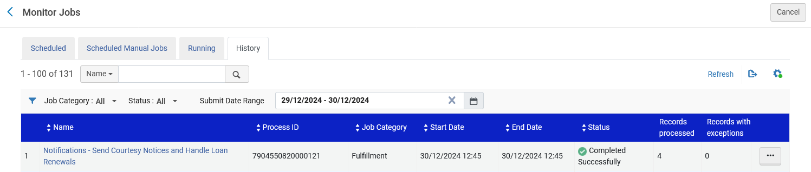
For example
Now we will look at the job "Notifications - Send Courtesy Notices and Handle Loan Renewals".
The job has run and completed.

Slide 17
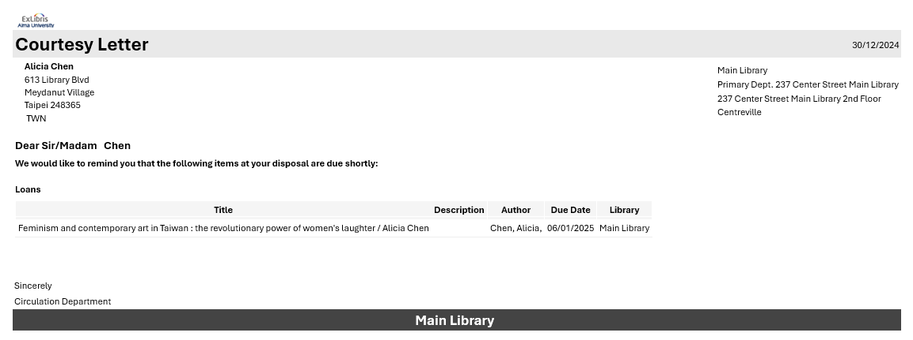
For example
Patron Alicia Chen receives two courtesy letters. Here is one for the Main Library.

Slide 18
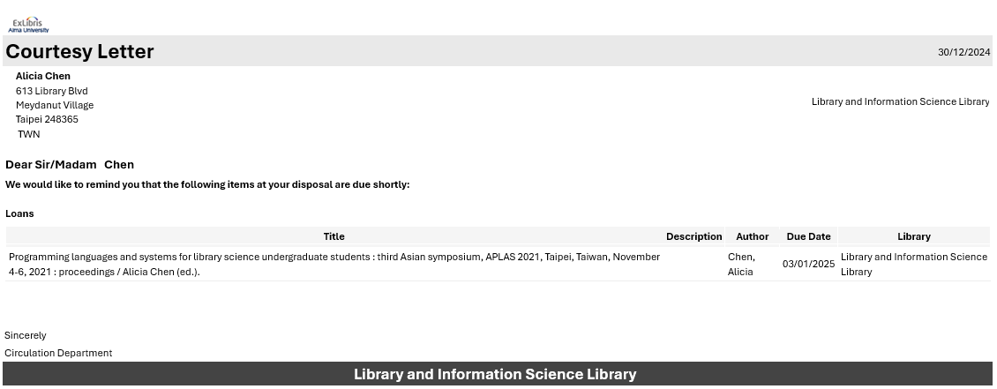
For example
Patron Alicia Chen receives two courtesy letters. Here is one for the Library and Information Science Library.

Slide 19
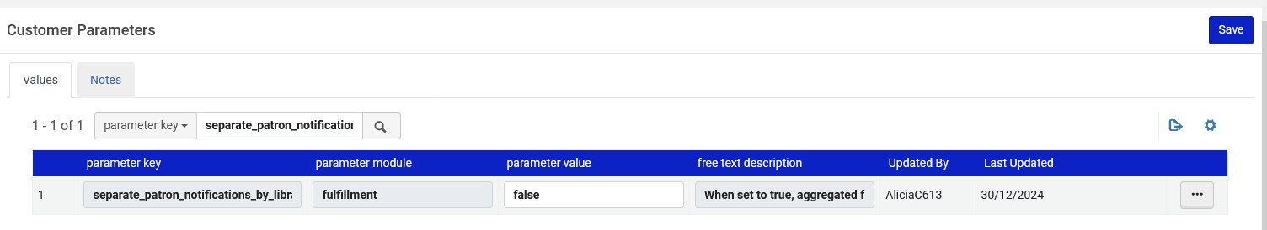
For example
However, if parameter separate_patron_notifications_by_library were set to false:

Slide 20
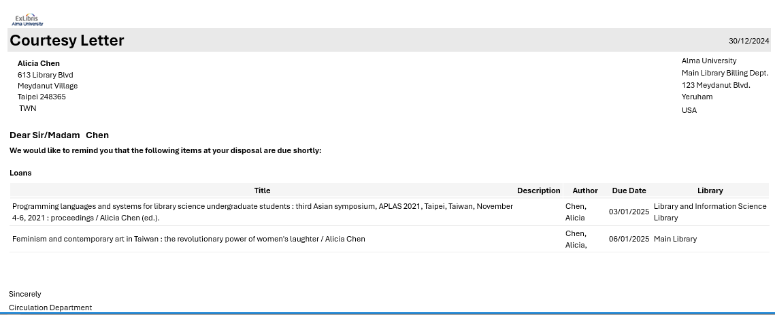
For example
Then patron Alicia Chen would get one courtesy letter with items from both libraries

Slide 21
Configurations based on library – Borrowing Activity Letter

Slide 22
Configurations based on library - Borrowing Activity Letter
Because each letter contains only one library, we can configure the letter to have a specific customization based on the library code.
We will show an example here using the Borrowing Activity Letter.
For a real live example of this see How to add a reply to message to the borrowing activity letter depending on the library of the loaned item(s).pptx
For example, we can make a "reply to" message or an image based on the library code of the loaned item(s).
For example, we can use the following field from the XML of the letter to make a condition: /notification_data/item_loans/item_loan/library_name

Slide 23
Configurations based on library - Borrowing Activity Letter
In our case we will do as follows to add a "reply to" notice on the top of the letter which will be different per library:
We will add:
<xsl:if test="/notification_data/item_loans/item_loan/library_name='Main Library'">
<center> <b> <font color = "red"> Reply to: Main_Library@alma_university.edu </font> </b> </center> </xsl:if>
<xsl:if test="/notification_data/item_loans/item_loan/library_name='Library and Information Science Library'">
<center> <b> <font color = "red"> Reply to: LIS_Library@alma_university.edu </font> </b> </center>
</xsl:if>

Slide 24
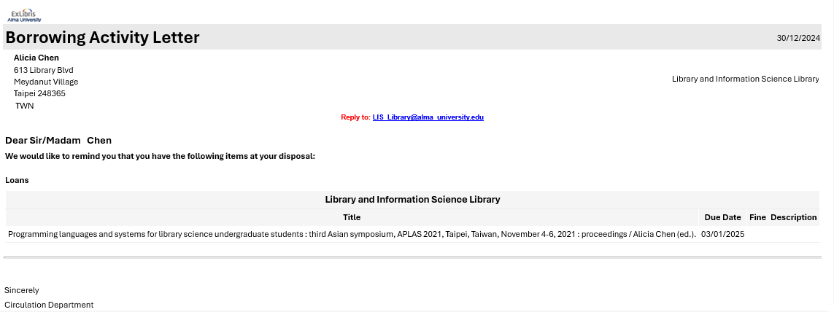
Configurations based on library - Borrowing Activity Letter
The letter for the "Library and Information Science Library" has a specific "Reply To" address

Slide 25
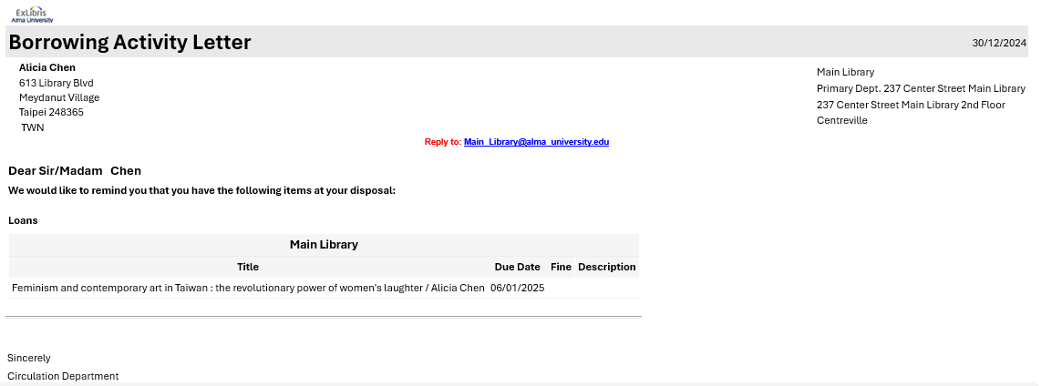
Configurations based on library - Borrowing Activity Letter
The letter for the "Main Library" has a specific "Reply To" address

Slide 26
xxx@exlibrisgroup.com

